Slide 1
Notaries, Amicable Divorce & Mediation in Europe: Demand, Capability Gaps, and the Role of Behavioral Insights
Preliminary Findings based on the JuWiLi II Behavioral Survey
12th of March 2026

Slide 2
Why this survey?
Build an evidence base across countries: Quantify notaries’ current roles, perceptions, and service provision (amicable divorce, mediation) and compare cross-country differences to understand where adoption is already strong vs. where additional potential exists.
Identify actionable levers for scaling impact: Pinpoint capability/training needs, perception gaps, and interest in behavioral-insight interventions to inform targeted programs (e.g., chamber-led training, standards, pilots) and prioritize next steps.
Derive actional policy recommendation: (→ JuWiLi II Behavioral study, Q3/26)

Slide 3
Who responded?
1657 notaries / notary candidates responded across 22 countries
Average age is 47, with most respondents in the mid-30s to mid-50s
Overall split is ~49% male / ~50% female
Disclaimer:
unless otherwise stated, missing values in the survey responses are not considered when computing descriptive statistics

Slide 4
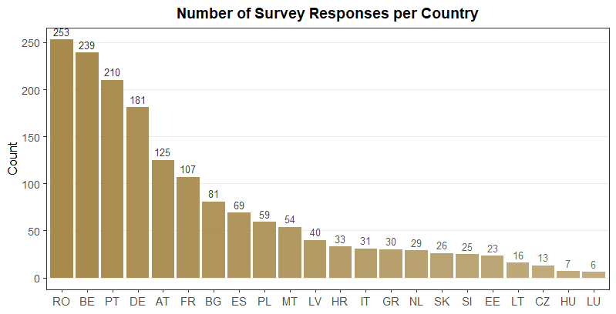
In total 1657 notaries & notary candidates across 22 countries answered the survey, i.e., about 75 responses per country on average

Slide 5
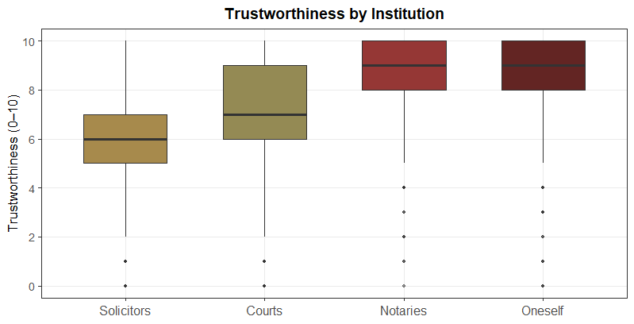
Notaries are perceived more trustworthy than courts and solicitors
Survey implementation:
“By trustworthiness, we mean earning the trust of others to act honestly, ethically, and reliably, so that others feel secure in relying on you.
How trustworthy do you perceive the services of … in your country from the perspective of potential clients?”

Slide 6
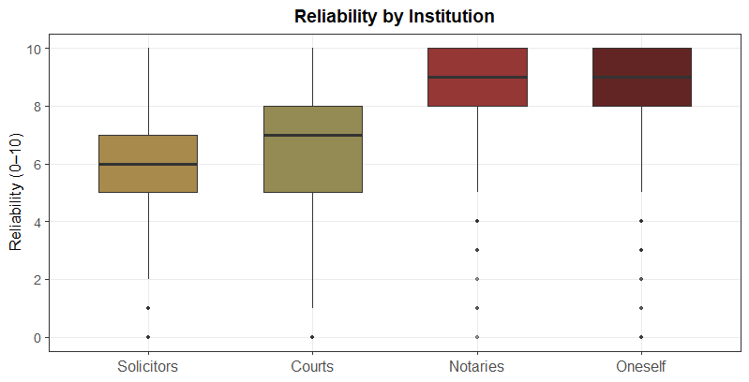
Notaries are perceived as more reliable than courts and solicitors
Survey implementation:
“By reliability, we mean consistently delivering good results and meeting expectations over an extended period.
How reliable do you perceive the services of … in your country from the perspective of potential clients?”

Slide 7
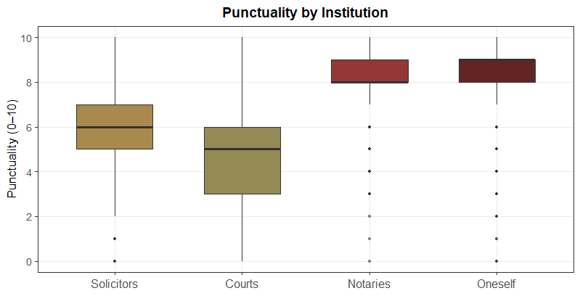
Notaries are perceived more punctual that solicitors and courts – with the latter being perceived as the least able to deliver in a timely manner
Survey implementation:
“By punctuality, we mean the ability to deliver expected results in a timely manner.
How punctual do you perceive the services of … in your country from the perspective of potential clients?”

Slide 8
Trust & Service Quality
When comparing the perception of Notaries, Courts and Solicitors:
Notaries lead on perceived service quality: Across countries, respondents rate notaries higher than courts and solicitors on all three dimensions shown (trustworthiness, reliability, punctuality).
While Courts are seen as more trustworthy and reliable than Solicitors, they are the weakest on timeliness

Slide 9
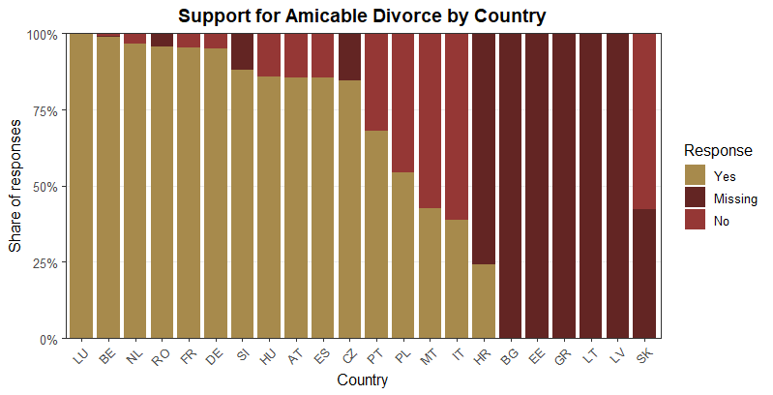
Over 72% of notaries support amicable divorce, but there is a huge heterogeneity across countries
Survey implementation:
“In your career as a notary, have you ever provided professional legal support in matters of amicable divorce?”

Slide 10
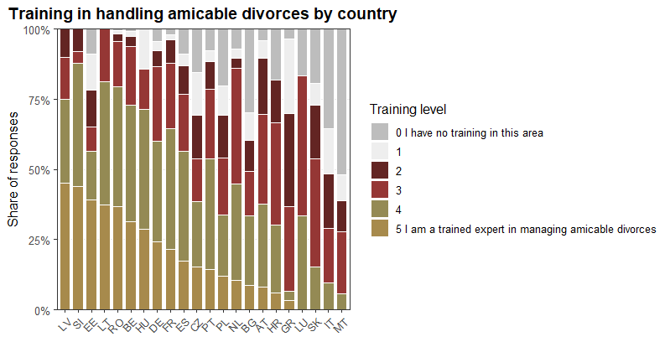
Training in amicable divorce handling varies widely across countries
Survey implementation:
“Do you consider yourself well-trained to handle couples seeking an amicable divorce?”

Slide 11
Amicable Divorce
Broad support, uneven adoption: Over 72% of notaries support amicable divorce, but support levels vary strongly by country
Potential capability gap: Self-reported training in handling amicable divorces is highly uneven

Slide 12
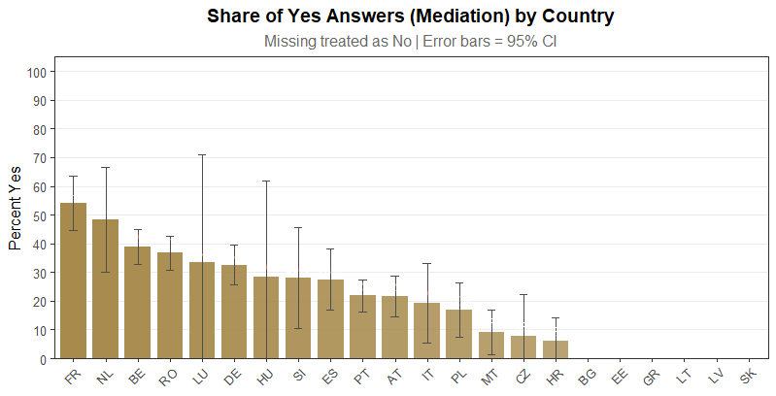
Only 22% of notaries state to offer mediation services, i.e., 78% currently do not
Survey implementation:
“Do you personally offer mediation services?“

Slide 13
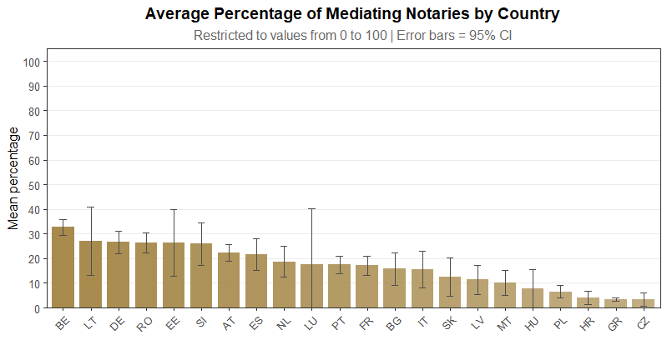
Notaries estimate that about 21% of all notaries in their country offer mediation services
Survey implementation:
“What percentage of notaries in your country do you estimate offer mediation services?“

Slide 14
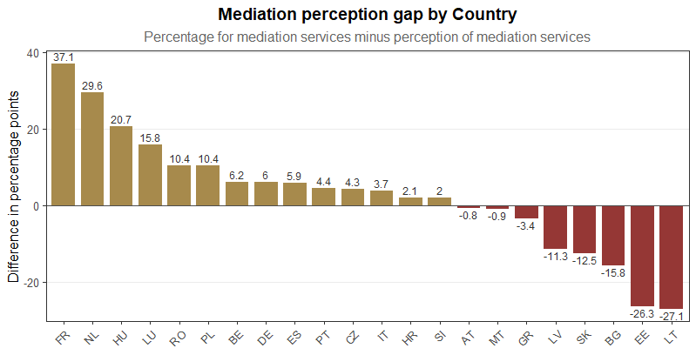
Overall the estimation how many notaries offer mediation services is almost on point (22% vs. 21%), BUT there are huge differences across countries
OVERestimating the proportion of other notaries offering mediation services
UNDERestimating the proportion of other notaries offering mediation services

Slide 15
Mediation Services
Mediation is still niche among notaries: Only ~22% of respondents say they personally offer mediation services (≈ 78% do not), with substantial cross-country variation.
Perceived market penetration is similar on average: Respondents estimate that ~21% of notaries in their country offer mediation
But perceptions diverge sharply by country: The perception gap swings strongly positive and negative depending on the country - some overestimate how common mediation is, while others underestimate, indicating uneven awareness/visibility of mediation services across markets.

Slide 16
The actual questions asked
To what extent do you believe the outcome of an amicable divorce can be influenced by
psychological framing?
suggesting an objectively reasonable proposal for asset division as a starting point?
presenting examples of how other couples have successfully navigated their amicable divorces?
demonstrating empathy and active listening towards both parties?
actively proposing a future-oriented approach to avoid dwelling on past conflicts?

Slide 17
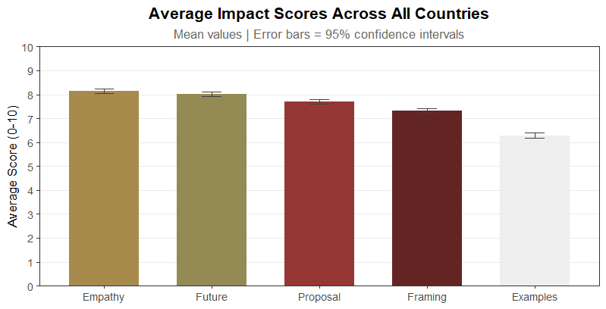
The expected impact of behavioral interventions is quite high, with some variation depending on the measure

Slide 18
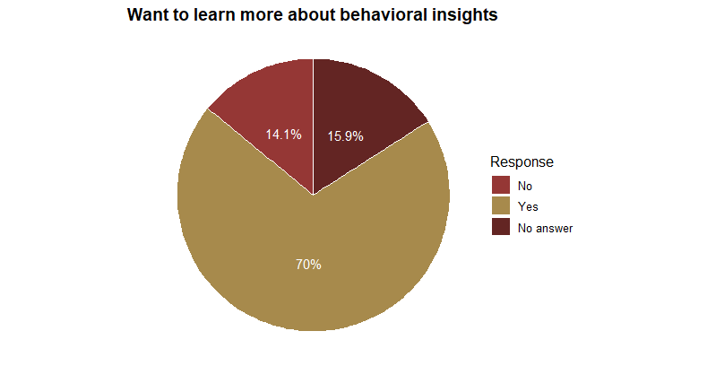
Two thirds of notaries are interested in learning more about how to apply behavioral insights
Survey implementation:
“Would you like to learn more about how to apply behavioural insights in your professional environment?“

Slide 19
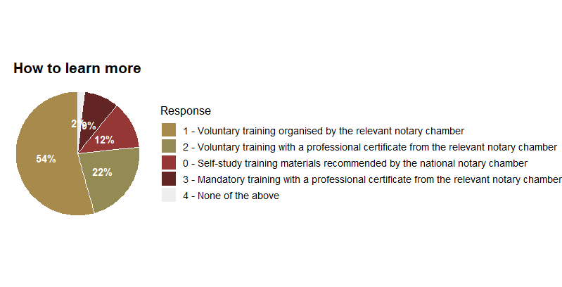
Most respondents want to learn via chamber-led voluntary training, with limited interest in mandatory programs

Slide 20
Attitudes towards Behavioral Interventions
Behavioral interventions are expected to have strong impact: Ratings are consistently high across measures
Clear appetite to build capability: About two thirds of notaries want to learn more about applying behavioral insights
Preferred learning format is voluntary and chamber-led, with little acceptance for compulsory formats

Slide 21
Conclusion & Outlook
Strong mandate, uneven readiness: Notaries are widely seen as more trustworthy, reliable, and punctual than courts/solicitors, and there is broad support for amicable divorce, but capabilities/training vary sharply by country, suggesting a scalability gap.
Mediation remains underused and inconsistently understood: Only 1 in 5 notaries report offering mediation, and while the overall perceived penetration is roughly accurate, country-level perception gaps are large, pointing to uneven visibility, awareness, or market structure.
Behavioral insights look high-impact with clear demand for upskilling: Expected impact scores are consistently high, two-thirds want to learn more, and the preferred route is voluntary, chamber-led training (with certification as a secondary option).

