Slide 1
Justice Without Litigation for Europe II
ECONOMIC PART
28th of November 2025

Slide 2
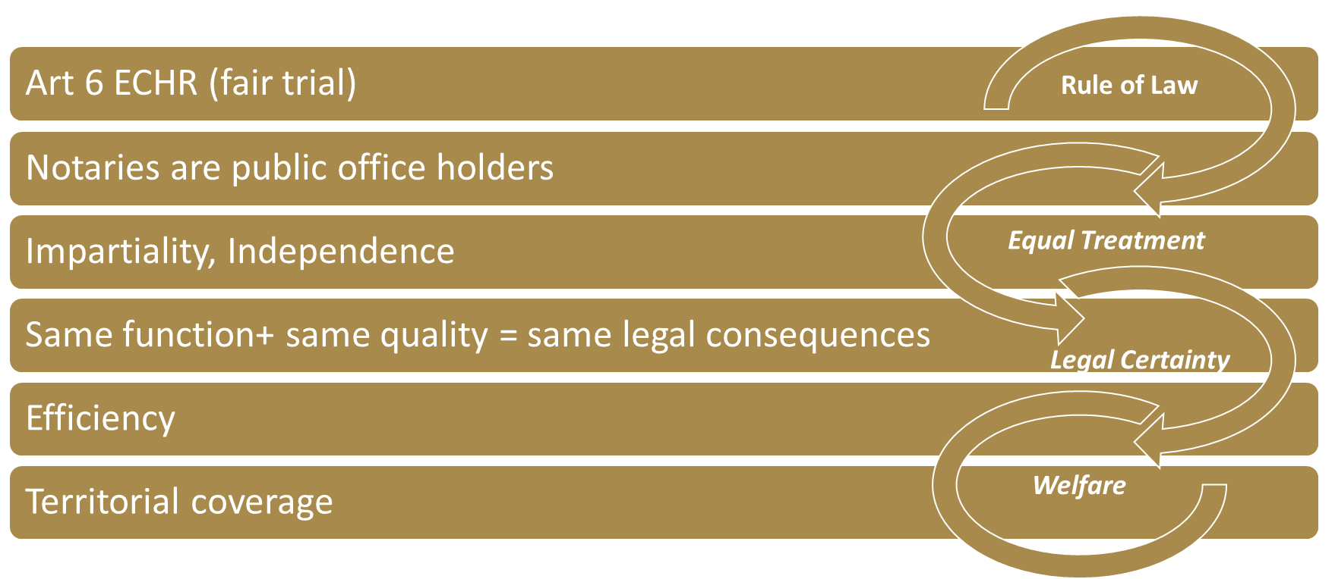
Conditions for outsourcing
State perspective
LEGAL
ECONOMIC
Welfare
Accessibility
Notes:
Article 6 of the European Convention on Human Rights declares the right of a fair trial, following the rule of law principle
How can Notaries guarantee the rule of law, which is a political ideal that all citizens and institutions within a country, state, or community are accountable to the same laws, including lawmakers and leaders.
First of all Notaries are public office holders, nominated by the public hand by following strict legal regulations.
Secondly a Notary has to act completely impartial and independent so that both parties involved are treated equal.
Together this results in the same function and same quality of Notarial services like courts provide, therefore the same legal certainty arises.
But beside legal certainty also the costs of the legal system is relevant for the common welfare.
A more efficient system in terms of economic expenditures with the same quality is pareto superior.
Last but not least the territorial coverage by Notarial offices across the country increases the physical accessibility
In general, there is a trend of outsourcing, which is reflected in modern EU instruments since 2012 (Successions, Brussels IIb, Taking of Evidence etc) And this trend takes-up speed.

Slide 3
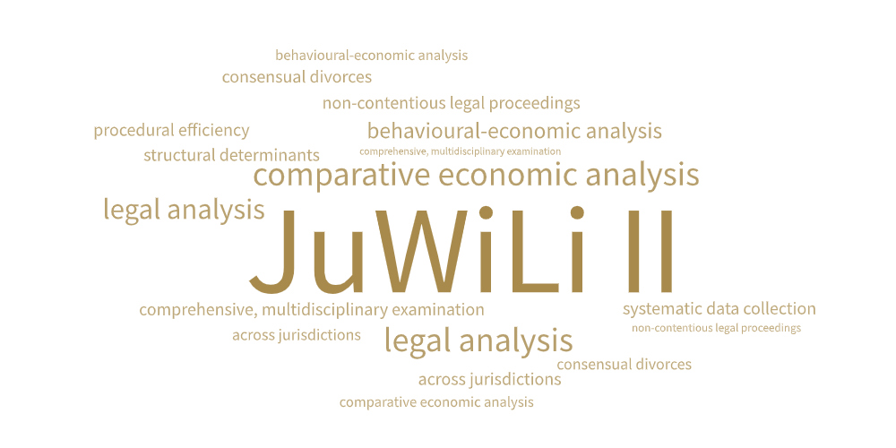
Jjustice Without Litigation II
Project Ouline
Notes:
Le me start with a brief recapitulation of the project
Starting from the initial situation and the related requirements we show how our solution approach looks like
Project Summary
This project undertakes a comprehensive, multidisciplinary examination of non-contentious legal proceedings across jurisdictions, with a particular emphasis on consensual divorces (as governed by the Brussels IIb Regulation) and succession procedures. By combining systematic data collection with comparative economic, behavioural-economic, and legal analysis, the project aims to identify structural determinants of procedural efficiency and to uncover shared features that may constitute common minimum standards in non-litigious processes. The research builds on the assumption that legal procedures not only operate within formal legal frameworks but also interact with economic incentives, institutional capacities, and the behavioural patterns of individuals and practitioners. Through this integrated approach, the project seeks to generate empirically grounded insights relevant for both academic discourse and policy development in the field of civil justice systems.
Solution Approach
Research Fields and Methods
The project adopts a methodological framework that integrates several complementary research dimensions:
Systematic Data Collection:
Collection and harmonisation of quantitative and qualitative data from multiple national legal systems, registries, and institutional reports to enable cross-country comparability.
Comparative Economic Analysis:
Evaluation of the cost structures, resource allocation, and efficiency levels of selected proceedings. This involves assessing transaction costs, administrative burdens, and potential efficiency gains resulting from alternative institutional designs.
Behavioural Economic Analysis:
Consideration of how users of the legal system—citizens, lawyers, notaries, judges—respond to incentives, complexity, and procedural design. This includes analysing biases, decision-making tendencies, and potential behavioural frictions.
Comparative Legal Analysis:
Identification of similarities and differences in procedural rules across jurisdictions, with the goal of deriving common minimum procedural standards that could enhance transparency, predictability, and overall system performance.
Project Goals
Extend the Economic Evaluation of Non-Contentious Legal Procedures:
Develop a more nuanced understanding of how legal procedures create or reduce economic burdens for courts, notaries, businesses, and individuals.
Identify Good or Best Practice Examples:
Detect institutional setups, procedural innovations, and regulatory frameworks that demonstrably improve efficiency, reduce delays, or enhance user experience.
Determine the Need for Reform or Improvement:
Assess whether existing procedures meet modern economic and institutional demands, and highlight areas where optimisation, harmonisation, or legislative refinement may be warranted.
Special Focus Areas
Consensual Divorces (Brussels IIb Regulation):
Analysis of how harmonised EU rules are implemented in practice, how procedural pathways differ across Member States, and what efficiency gains or behavioural effects arise from alternative institutional designs (e.g., court-led vs. notary-led processes).
Successions:
Examination of inheritance procedures, including the role of notaries, courts, and registries, with a focus on procedural complexity, costs, and cross-border implications in the EU context.

Slide 4








Research Dimensions and Structure
Geographic Area
→ 22 EU-MS
Indicators
Welfare
Proceedings
→ Case Statistics
Efficiency
Expenditures
Transparency
Accessibility
→ Citizen-centred
Policy Conclusions
Notes:
The main objective of the study is to analyze
the role of Notaries in the execution of non-contentious legal proceedings and
the socio-economic impact of outsourcing court roles to the Notaries in the JuWiLi 2 participating countries.
We have to examine countries concerning the non-contentious proceedings in detail, with a special focus on successions and consensual divorces
For the general legal infrastructure we will base our analysis on the whole European Union.
The Efficiency dimensions will be based on the CEPEJ statistics for other legal proceedings.
The Quality aspects are strong connected to the efficiency dimensions.
Accessibility and Innovation possess in terms of digital solutions commonalities.
The proposed Indicators should enhance the transparency in terms of efficiency, quality, accessibility and innovation.
Finaly to derive policy conclusions the concept of maximising the welfare will be included.

Slide 5
Geographic Area
Heterogeneity of Countries
Population
Millions
Notes:
“The countries under consideration differ not only in their legal frameworks, but also in their economic structures and demographic characteristics.”
“The countries under analysis exhibit substantial heterogeneity not only in their respective legal systems, but also in their underlying economic conditions and the demographic composition of their populations.”

Slide 6
Proceedings
Case Statistics
Overall Legal System
Notary System
Total other than criminal cases
Civil (and commercial) litigious cases
Total non-litigious cases
Civil (and commercial) non-litigious cases
Total registry cases
Land registry cases
Business registry cases
Other registry cases
Other non-litigious cases
Administrative law cases
Other cases
Legal area of non-contentious cases
Succession
Divorces
Marriages
Land registry
Business registry
Notes:
Proceedings Described by Legal Statistics
When analysing legal systems from an economic or institutional perspective, proceedings are often categorised according to standard statistical classifications. These typically include:
Overall Legal System
Total non-criminal cases
Civil (and commercial) litigious cases
Total non-litigious cases
Civil (and commercial) non-litigious cases
Total registry cases
Land registry cases
Business registry cases
Other registry cases
Other non-litigious cases
Administrative law cases
Other cases
These categories capture the full spectrum of judicial and quasi-judicial activity, including both adversarial (litigious) and administrative or registration-based proceedings.
Notary System
In many jurisdictions, notarial institutions manage a substantial portion of non-contentious legal matters. Relevant statistical categories typically include:
Non-contentious legal matters (overall)
Succession (inheritance) proceedings
Divorce (non-contentious)
Marriage-related procedures
Land registry functions handled by notaries
Business registry procedures handled by notaries
These distinctions help clarify the division of responsibilities between courts and notarial bodies, which is crucial for understanding procedural efficiency, transaction costs, and institutional workload in different legal systems.

Slide 7
Proceedings - Indicators
Key Figures
Clearance rate (CR) - ratio obtained by dividing the number of resolved cases by the number of incoming cases in a given period.
Work Overload (WO) - ratio obtained by dividing the number of incoming and pending cases 1st of January by the number of resolved cases by cases in a given period.
Stake Change (SC) - ratio obtained by dividing the number of pending cases 1st of January by the number of pending Cases 31st December cases by cases in a given period.
Disposition time - ratio between pending cases and resolved cases (in days). It is the calculated time necessary for a pending case to be resolved, considering the current pace of work of courts.
Notes:
Clearance rate (CR) - ratio obtained by dividing the number of resolved cases by the number of incoming cases in a given period.
Work Overload (WO) - ratio obtained by dividing the number of incoming and pending cases 1st of January by the number of resolved cases by cases in a given period.
Stake Change (SC) - ratio obtained by dividing the number of pending cases 1st of January by the number of pending Cases 31st December cases by cases in a given period.
Disposition time - ratio between pending cases and resolved cases (in days). It is the calculated time necessary for a pending case to be resolved, considering the current pace of work of courts.

Slide 8
Proceedings - Indicators
Key Figures for Slovenian Notaries
Clearance Rate (CR): Stable Clearance Rate of 100% for all Notarial cases.
Work Overload (WO): Slovenian Notaries show no work overload
Stake Change (SC): Very stable low stake for Notarial cases over time.
Disposition Time (DT): DT for Notarial cases is very low (days).
good case handling process
+ sufficient capacity building / planning
→ fast case resolving
Notes:
Efficiency and Quality: Key Figures for Slovenia
Clearance Rate (CR)
Slovenia exhibits a consistently high level of procedural efficiency in notarial proceedings.
The clearance rate for all notarial cases remains stable at 100%, indicating that inflows and outflows of cases are in balance and that backlogs do not accumulate.
For the broader category of total non-litigious cases, Slovenia even records clearance rates above 100% in 2014, 2016, and 2018, reflecting the ability of institutions to reduce existing stocks of pending cases during these periods.
Work Overload (WO)
Capacity indicators show marked differences between notarial and court-handled non-litigious proceedings.
Notarial offices show no signs of work overload, suggesting that the current organisational structure and staffing levels provide sufficient capacity for the caseload they manage.
In contrast, work overload for total non-litigious cases—primarily within the judiciary—declined significantly from 28% in 2014 to 9% in 2022.
Although improved, this still indicates a remaining capacity gap and potential pressure points within court-based non-contentious procedures.
Stake Change (SC)
Notarial cases display a very stable and consistently low stake level over time, indicating that the complexity and resource requirements have not materially changed.
For total non-litigious cases, the above-100% clearance rates in certain years have produced a reduction in stake levels, as backlogs were processed and the number of pending cases declined.
Disposition Time (DT)
The time required to resolve cases highlights substantial disparities between notarial and court-administered procedures.
For notarial cases, disposition times are exceptionally short, remaining below three days. This reflects high procedural efficiency, streamlined workflows, and strong administrative capacity.
By contrast, total non-litigious cases still required more than 30 days to be resolved in 2022, despite improvements over the decade.
For context, the 2014 disposition time was approximately 100 days, indicating substantial, though incomplete, progress in reducing delays.

Slide 9
Legal Expenditures
in Relation to the Gross Domestic Product
Public Expenditures
Total Expenditures

Slide 10
Efficiency
Private and Public Expenditures of the whole Legal System
Welfare
Efficiency
Notes:
Efficiency and Quality Objective
A core objective of the analysis is to maximize citizens’ welfare by minimizing both private and public expenditures associated with the functioning of the legal system. This involves reducing the financial and time-related burdens borne by individuals, households, businesses, and public institutions, while at the same time maintaining or improving the quality, accessibility, and reliability of legal procedures. Enhancing efficiency—without compromising fairness, legal certainty, or procedural safeguards—constitutes a critical criterion for assessing the performance of non-contentious legal processes within and across jurisdictions.

Slide 11
Accessibility
Citizen-centred Justice System
The Austrian Showcase.
Distance to the next
Notary office
Court
Regions
2.093 Communities (Local Authority Units)

Slide 12
Accessibility
Citizens Distance
Notaries vs. Courts
Share of Citizens | Notaries | Courts
50% | 3,37 | 4,50
90% | 9,90 | 15,60
95% | 12,00 | 18,80
99% | 17,80 | 25,00

Slide 13
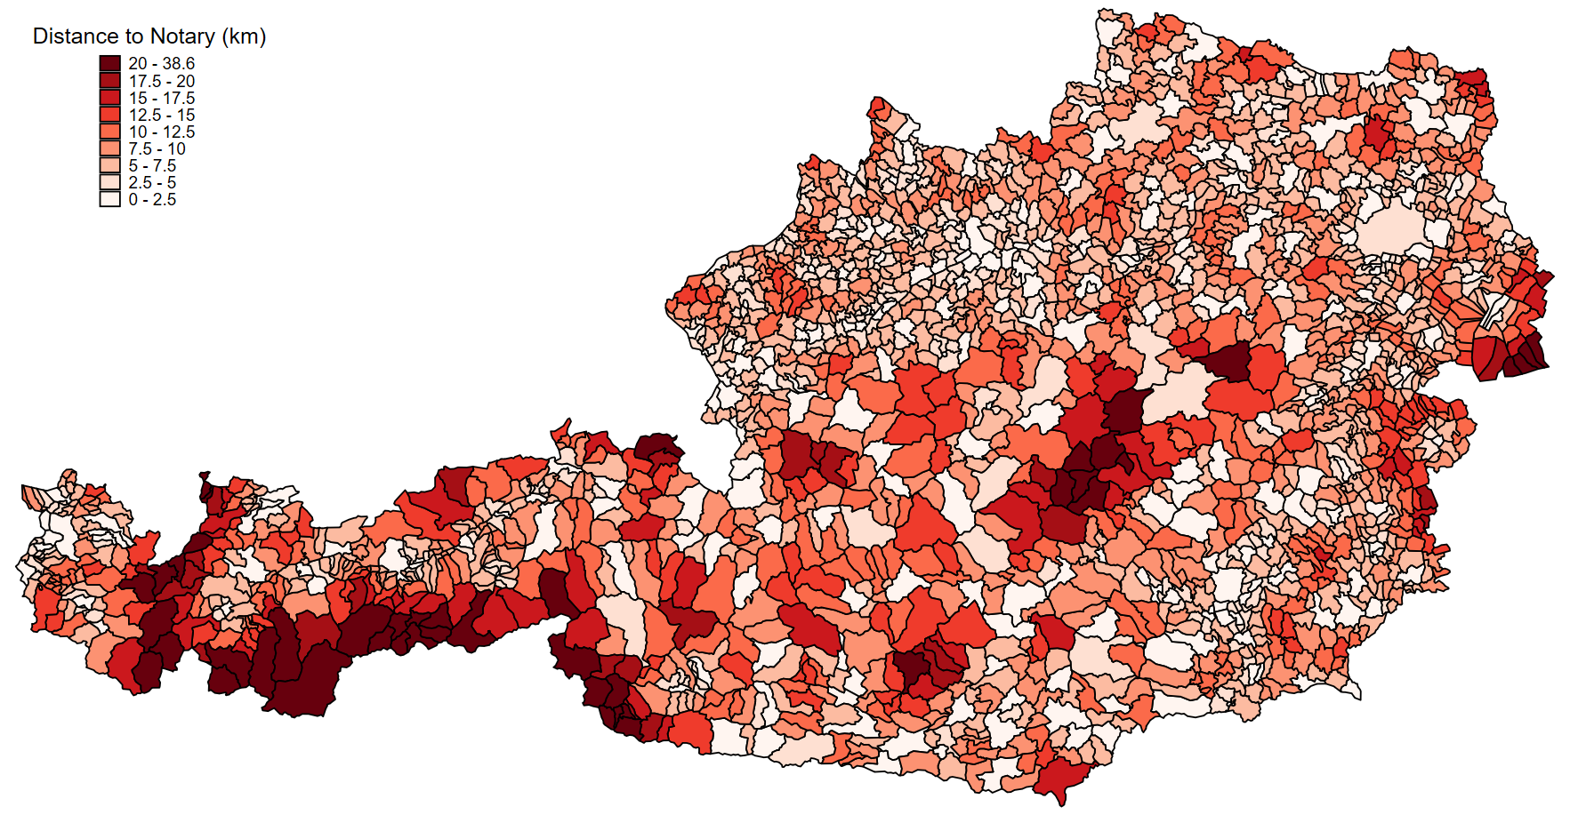
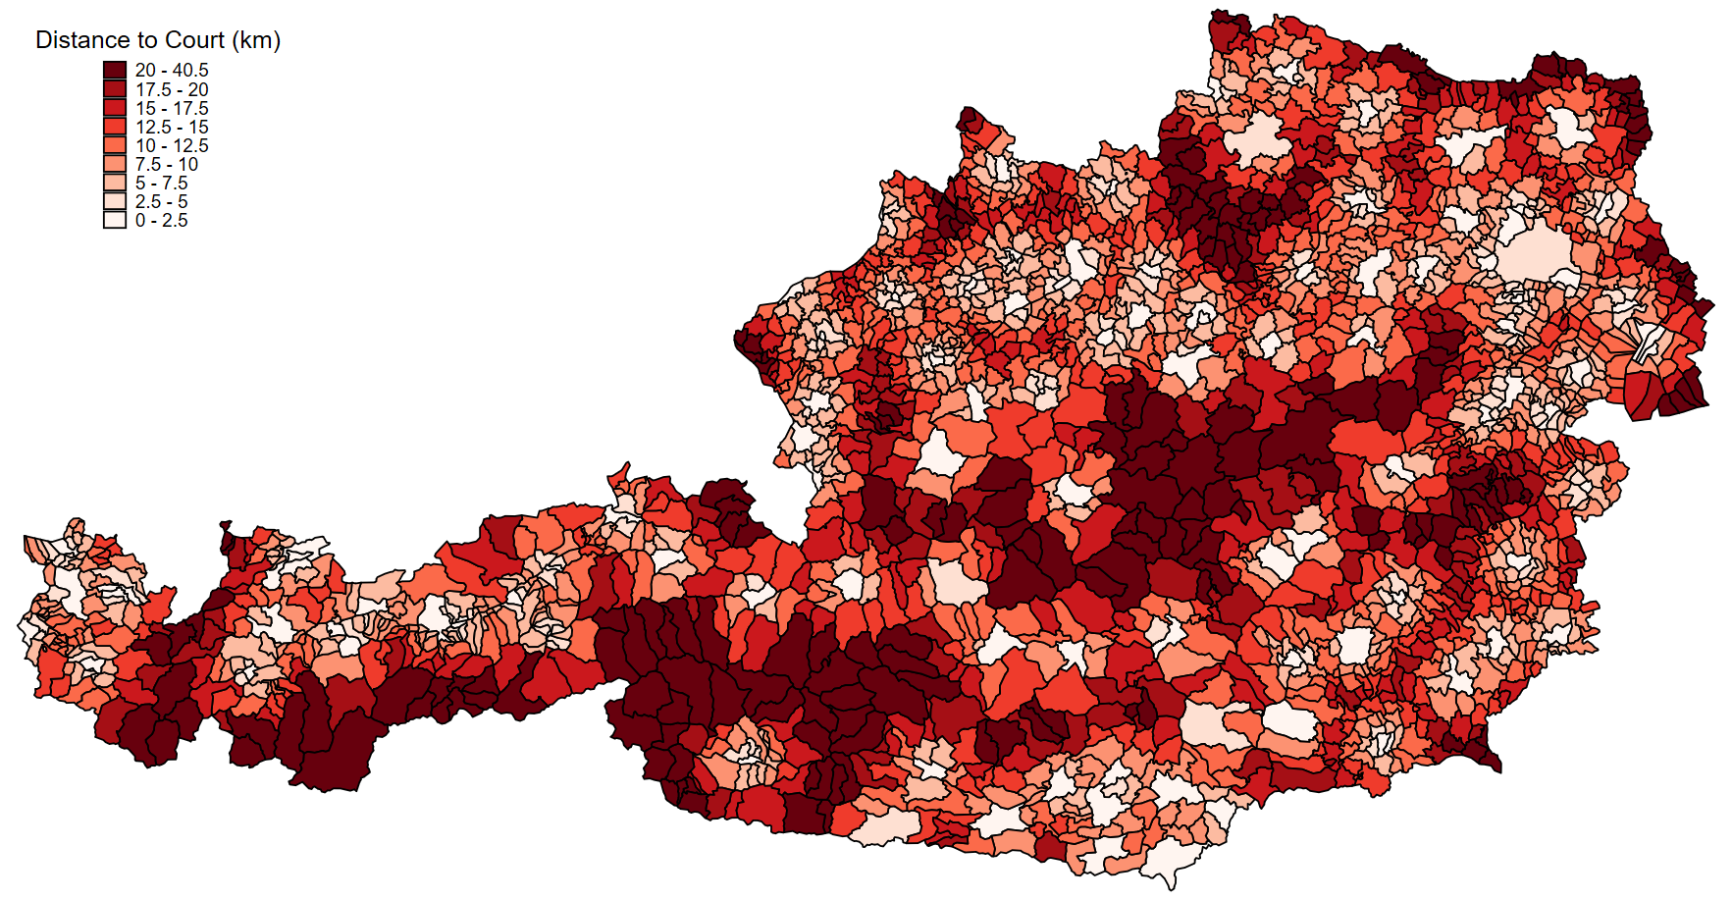
Accessibility
Map of Citizens Distance
Court Locations

Slide 14
Accessibility
Map of Citizens Distance
Notary Locations

Slide 15

Co-funded by the European Union

Slide 16
Project Summary
Initial Situation and Solution Approach
Notes:
Le me start with a brief recapitulation of the project
Starting from the initial situation and the related requirements we show how our solution approach looks like
Project Summary
This project undertakes a comprehensive, multidisciplinary examination of non-contentious legal proceedings across jurisdictions, with a particular emphasis on consensual divorces (as governed by the Brussels IIb Regulation) and succession procedures. By combining systematic data collection with comparative economic, behavioural-economic, and legal analysis, the project aims to identify structural determinants of procedural efficiency and to uncover shared features that may constitute common minimum standards in non-litigious processes. The research builds on the assumption that legal procedures not only operate within formal legal frameworks but also interact with economic incentives, institutional capacities, and the behavioural patterns of individuals and practitioners. Through this integrated approach, the project seeks to generate empirically grounded insights relevant for both academic discourse and policy development in the field of civil justice systems.
Solution Approach
Research Fields and Methods
The project adopts a methodological framework that integrates several complementary research dimensions:
Systematic Data Collection:
Collection and harmonisation of quantitative and qualitative data from multiple national legal systems, registries, and institutional reports to enable cross-country comparability.
Comparative Economic Analysis:
Evaluation of the cost structures, resource allocation, and efficiency levels of selected proceedings. This involves assessing transaction costs, administrative burdens, and potential efficiency gains resulting from alternative institutional designs.
Behavioural Economic Analysis:
Consideration of how users of the legal system—citizens, lawyers, notaries, judges—respond to incentives, complexity, and procedural design. This includes analysing biases, decision-making tendencies, and potential behavioural frictions.
Comparative Legal Analysis:
Identification of similarities and differences in procedural rules across jurisdictions, with the goal of deriving common minimum procedural standards that could enhance transparency, predictability, and overall system performance.
Project Goals
Extend the Economic Evaluation of Non-Contentious Legal Procedures:
Develop a more nuanced understanding of how legal procedures create or reduce economic burdens for courts, notaries, businesses, and individuals.
Identify Good or Best Practice Examples:
Detect institutional setups, procedural innovations, and regulatory frameworks that demonstrably improve efficiency, reduce delays, or enhance user experience.
Determine the Need for Reform or Improvement:
Assess whether existing procedures meet modern economic and institutional demands, and highlight areas where optimisation, harmonisation, or legislative refinement may be warranted.
Special Focus Areas
Consensual Divorces (Brussels IIb Regulation):
Analysis of how harmonised EU rules are implemented in practice, how procedural pathways differ across Member States, and what efficiency gains or behavioural effects arise from alternative institutional designs (e.g., court-led vs. notary-led processes).
Successions:
Examination of inheritance procedures, including the role of notaries, courts, and registries, with a focus on procedural complexity, costs, and cross-border implications in the EU context.

Slide 17
Project summary
Solution Approach
Research fields
systematic data collection,
comparative economic analysis
behavioural economic analysis
comparative legal analysis → identification of common minimum procedural standards
Goals
extend the economic evaluation,
identify good / best practice examples in terms of efficiency increases and
figure out eventual need for improvements
Special focus areas
consensual divorces (Brussels IIb Reg.) and
successions
Notes:
Project Summary
This project undertakes a comprehensive, multidisciplinary examination of non-contentious legal proceedings across jurisdictions, with a particular emphasis on consensual divorces (as governed by the Brussels IIb Regulation) and succession procedures. By combining systematic data collection with comparative economic, behavioural-economic, and legal analysis, the project aims to identify structural determinants of procedural efficiency and to uncover shared features that may constitute common minimum standards in non-litigious processes. The research builds on the assumption that legal procedures not only operate within formal legal frameworks but also interact with economic incentives, institutional capacities, and the behavioural patterns of individuals and practitioners. Through this integrated approach, the project seeks to generate empirically grounded insights relevant for both academic discourse and policy development in the field of civil justice systems.
Solution Approach
Research Fields and Methods
The project adopts a methodological framework that integrates several complementary research dimensions:
Systematic Data Collection:
Collection and harmonisation of quantitative and qualitative data from multiple national legal systems, registries, and institutional reports to enable cross-country comparability.
Comparative Economic Analysis:
Evaluation of the cost structures, resource allocation, and efficiency levels of selected proceedings. This involves assessing transaction costs, administrative burdens, and potential efficiency gains resulting from alternative institutional designs.
Behavioural Economic Analysis:
Consideration of how users of the legal system—citizens, lawyers, notaries, judges—respond to incentives, complexity, and procedural design. This includes analysing biases, decision-making tendencies, and potential behavioural frictions.
Comparative Legal Analysis:
Identification of similarities and differences in procedural rules across jurisdictions, with the goal of deriving common minimum procedural standards that could enhance transparency, predictability, and overall system performance.
Project Goals
Extend the Economic Evaluation of Non-Contentious Legal Procedures:
Develop a more nuanced understanding of how legal procedures create or reduce economic burdens for courts, notaries, businesses, and individuals.
Identify Good or Best Practice Examples:
Detect institutional setups, procedural innovations, and regulatory frameworks that demonstrably improve efficiency, reduce delays, or enhance user experience.
Determine the Need for Reform or Improvement:
Assess whether existing procedures meet modern economic and institutional demands, and highlight areas where optimisation, harmonisation, or legislative refinement may be warranted.
Special Focus Areas
Consensual Divorces (Brussels IIb Regulation):
Analysis of how harmonised EU rules are implemented in practice, how procedural pathways differ across Member States, and what efficiency gains or behavioural effects arise from alternative institutional designs (e.g., court-led vs. notary-led processes).
Successions:
Examination of inheritance procedures, including the role of notaries, courts, and registries, with a focus on procedural complexity, costs, and cross-border implications in the EU context.

Slide 18
Economic analysis
Work package WP3 – Study part II
Objectives
Provide an overview of the various national justice systems within the EU based on statistical data.
Establish a data base on non-contentious proceedings for the partner countries of the project.
Identification of best practice for non-contentious proceedings.
Analysis of behavioural factors in the field of non-contentious proceedings.
Providing a study that presents a comparative analysis of the social and economic impact of outsourcing non-contentious justice to notaries.
Drafting recommendations and conclusions addressed to policymakers.

Slide 19
Geographic Area
Hetereogeneity of Countries
Population
Economy
Notes:
“The countries under consideration differ not only in their legal frameworks, but also in their economic structures and demographic characteristics.”
“The countries under analysis exhibit substantial heterogeneity not only in their respective legal systems, but also in their underlying economic conditions and the demographic composition of their populations.”

Slide 20
Efficiency / Quality
Key Figures for Slovenia
Clearance Rate (CR): Stable Clearance Rate of 100% for all Notarial cases. Total non-litigious possess in the years 2014, 2016 and 2018 a CR above 100 %.
Work Overload (WO): Slovenian Notaries show no work overload → sufficient capacity WO of total non-litigious cases is decreasing from 2014 (28%) to 2022 (9 %) → still lack of capacity .
Stake Change (SC): Very stable low stake for Notarial cases over time. Due to CR of above 100 % SC reduction for total non-litigious cases Disposition Time (DT): DT for Notarial cases is below 3 days. Total non-litigious cases have still (2022) a DT above 30 days. (2014 = 100 days)
Notes:
Efficiency and Quality: Key Figures for Slovenia
Clearance Rate (CR)
Slovenia exhibits a consistently high level of procedural efficiency in notarial proceedings.
The clearance rate for all notarial cases remains stable at 100%, indicating that inflows and outflows of cases are in balance and that backlogs do not accumulate.
For the broader category of total non-litigious cases, Slovenia even records clearance rates above 100% in 2014, 2016, and 2018, reflecting the ability of institutions to reduce existing stocks of pending cases during these periods.
Work Overload (WO)
Capacity indicators show marked differences between notarial and court-handled non-litigious proceedings.
Notarial offices show no signs of work overload, suggesting that the current organisational structure and staffing levels provide sufficient capacity for the caseload they manage.
In contrast, work overload for total non-litigious cases—primarily within the judiciary—declined significantly from 28% in 2014 to 9% in 2022.
Although improved, this still indicates a remaining capacity gap and potential pressure points within court-based non-contentious procedures.
Stake Change (SC)
Notarial cases display a very stable and consistently low stake level over time, indicating that the complexity and resource requirements have not materially changed.
For total non-litigious cases, the above-100% clearance rates in certain years have produced a reduction in stake levels, as backlogs were processed and the number of pending cases declined.
Disposition Time (DT)
The time required to resolve cases highlights substantial disparities between notarial and court-administered procedures.
For notarial cases, disposition times are exceptionally short, remaining below three days. This reflects high procedural efficiency, streamlined workflows, and strong administrative capacity.
By contrast, total non-litigious cases still required more than 30 days to be resolved in 2022, despite improvements over the decade.
For context, the 2014 disposition time was approximately 100 days, indicating substantial, though incomplete, progress in reducing delays.

Slide 21
Work ahead for the Economic part
Country-specific profiles (non-comparative)
Assessment and analysis of the questionnaire
Macro-economic Analysis of Efficiency
Analysis on the accessibility of notaries (distance matrices)
Combining the findings with the “behavioural analysis” and other work packages

Slide 22
Court Costs
Gross Domestic Product

Slide 23
Whole justice system
Gross Domestic Product
Budget in Relation to

Slide 24
Accessibility
Map of Citizens Distance
Notary Locations
Court Locations

